Slide 1
PREVIOUS CLASSES
1- Error analysis
2- Precession, Resolution etc.
3- Examples of different applications of Vacuum Techniques
4- Units of Pressure and its conversions
5- Basics of Gas Properties
6- Gas laws
7- Velocity of gasses etc.
8- Molecular incident rate, Mean free path
9- Viscosity and diffusion of gases
10- Thermal diffusion: Distinction of gas flow and connections
1- Question: Modify the design of McLeod gauge for the better resolution of pressure measurement
2- Write a computer programme (Software development) to calculate the conductance for different connection design
3- Write a computer programme to calculate the throughput and pumping speed required for the vacuum chamber
Pumping speed and
Vacuum PUMPS

Slide 2
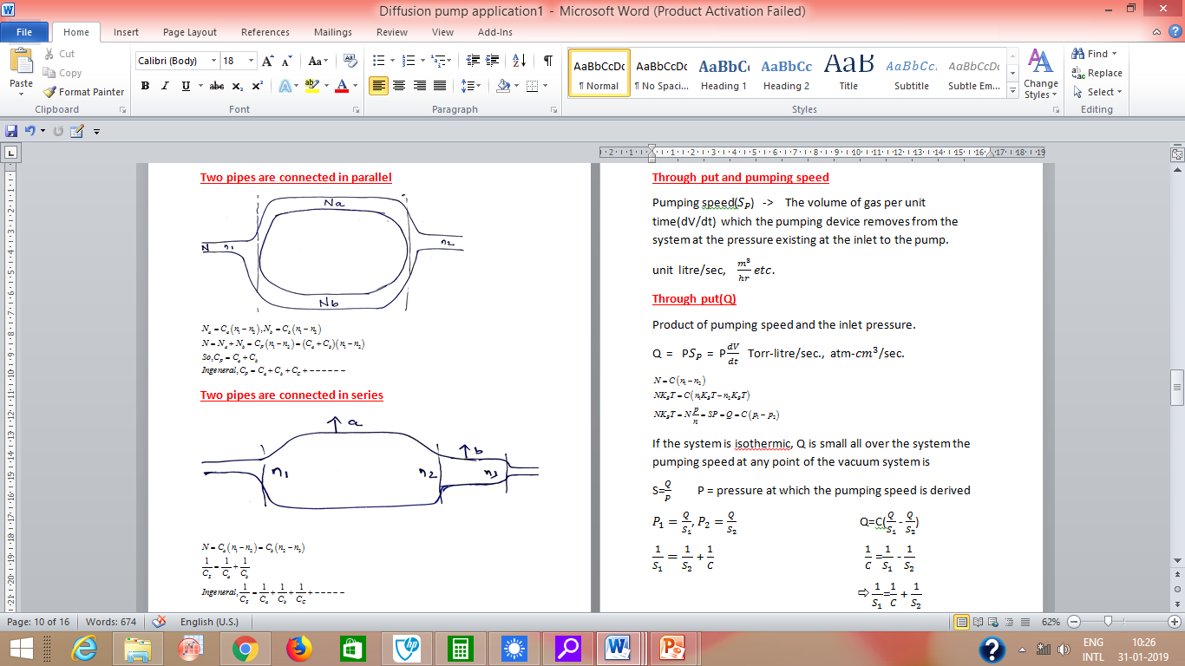

Slide 3
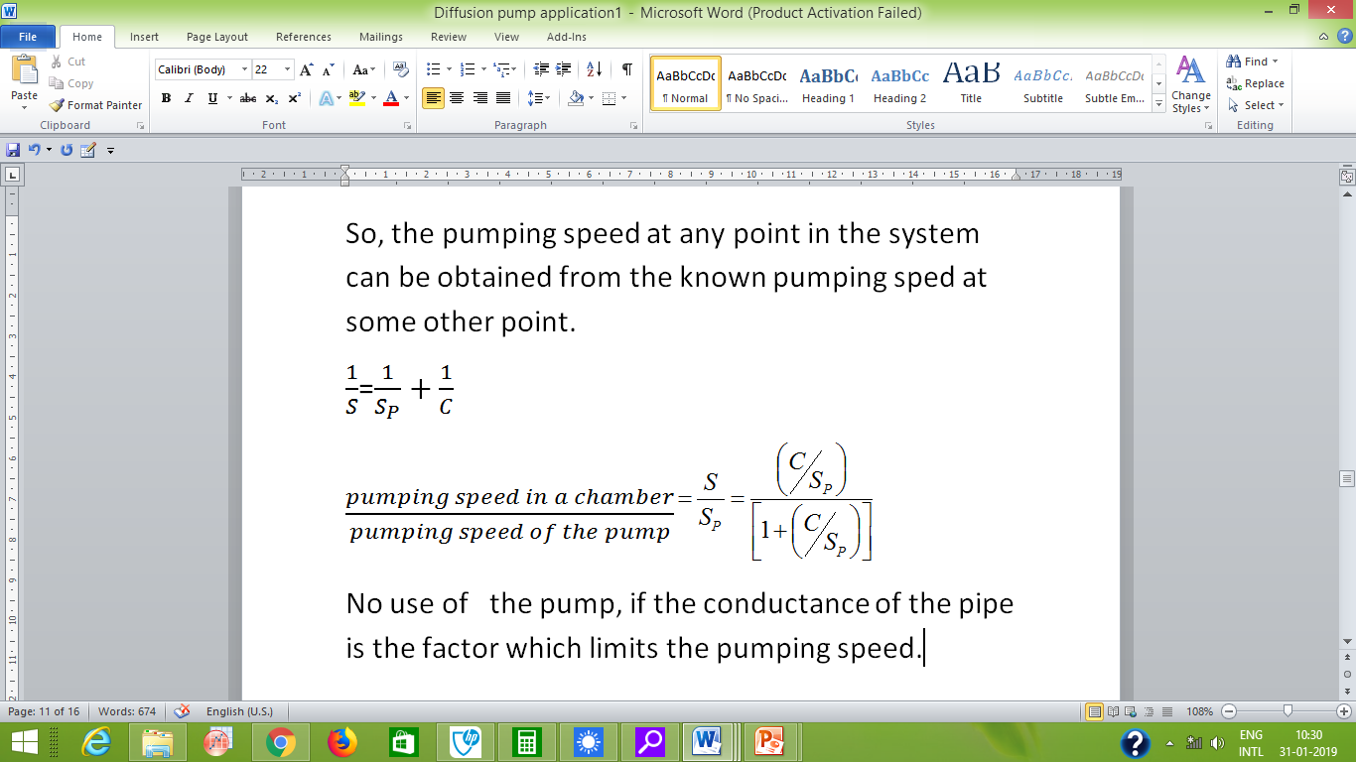

Slide 4
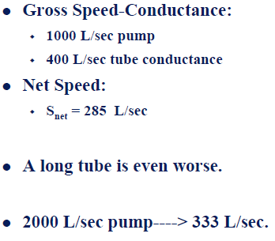
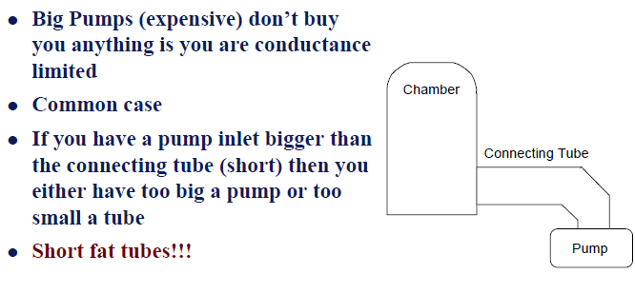
Pumping Speed and Conductance
Conductance Limitation
Vacuum Pumps

Slide 5
Vacuum pumping is based on one or more of the following principles:
Compression-Expansion of the gas: Ex- Piston pumps, Liquid column or Liquid ring pumps, Roots pumps
Drag by viscosity effects: Ex-Vapor ejector pumps
Drag by diffusion effects: Vapor diffusion pumps
Molecular Drag Pump: Molecular Pumps
Ionization Effects: Ion Pumps
Physical or Chemical Sorption: Sorption pumps, Cryopumps & gettering processes
Parameters
Lowest pressure ( Which can achieved by a pump at its inlet)
The pressure range (Pressure Range in which the pumping speed can be considered useful)
The pumping speed
The exhaust pressure
Selectivity of the pump
Composition of the residual gas.

Slide 6
what is a Vacuum Pump?
A pump removes gas from the volume of interest
Transport through compression ( Bulk action)
Mechanical “compressor”
Momentum transfer directly to molecules ( molecular action )
Collisions with Macroscopic Items
Entrainment: Collisions with other molecules.
Immobilization: Store at surfaces for a time >>> time of experiment
Most vacuum pumps only work over a:
Limited range of conditions
Limited types of gases

Slide 7
Pumping Concepts
Storage Pumps
Compression Pumps and Transport Pumps
Compression losses its familiar meaning when we have very low density molecular space
More easily understandable is the concept of “diode”
A pump is a diode for gas flow!
Difference between “forward” and “reverse” transition probability will sustain a pressure difference
“rectification”
A pump is something that can sustain a pressure differential

Slide 8
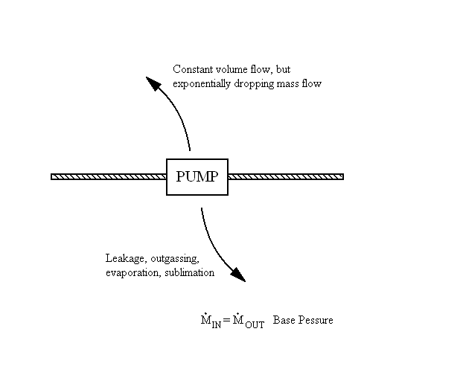
It can be considered that the sources of gas in a vacuum system are as follows:
1- The gas molecules of the initial atomsphere enclosed in the system (Q)
2- The gas which penetrates into the system as a result of leakage (Q_{L})
3- The gas provening from the outgassing of the materials in the system (Q_{D})
4- The gas (or vapours) resulting from the vapor pressure of the materials (Q_{V})
5- The gas entering the system by permeation through walls, windows (Q_{P})
From 2-5 are the function of the construction
Q_{G}=Q_{L}+Q_{D}+Q_{V}+Q_{P}

Slide 9
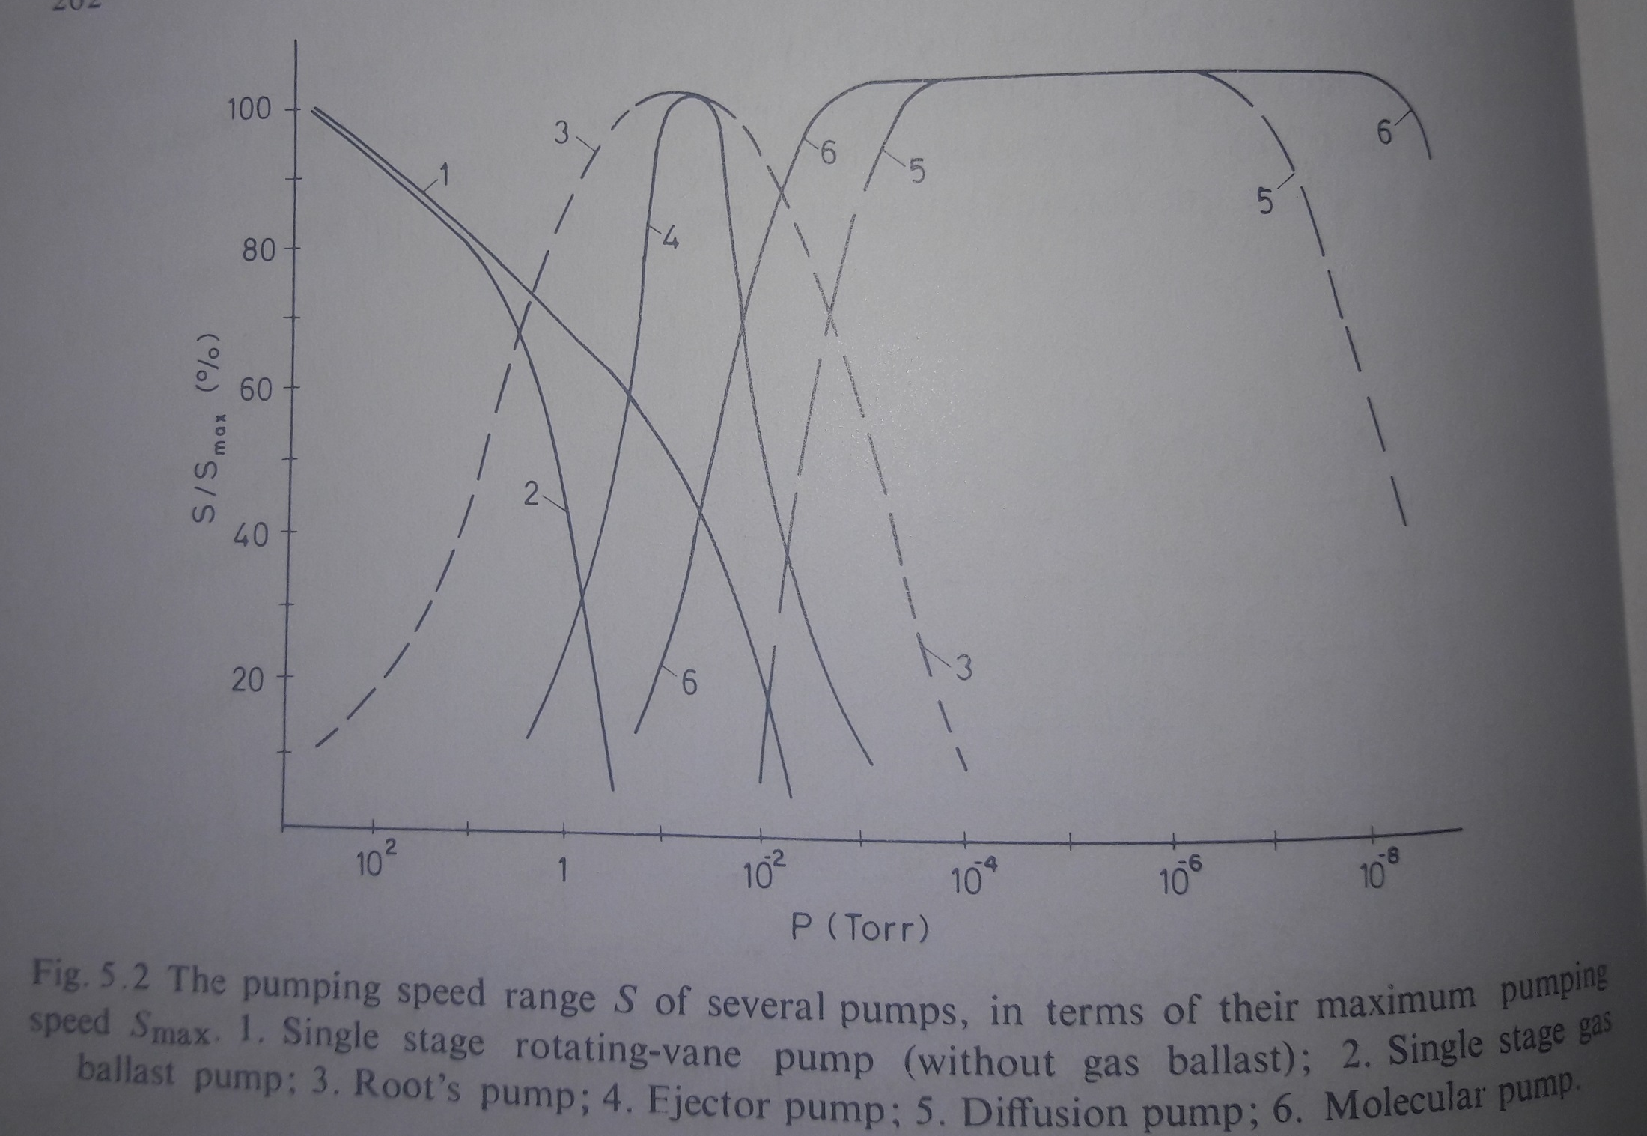

Slide 10
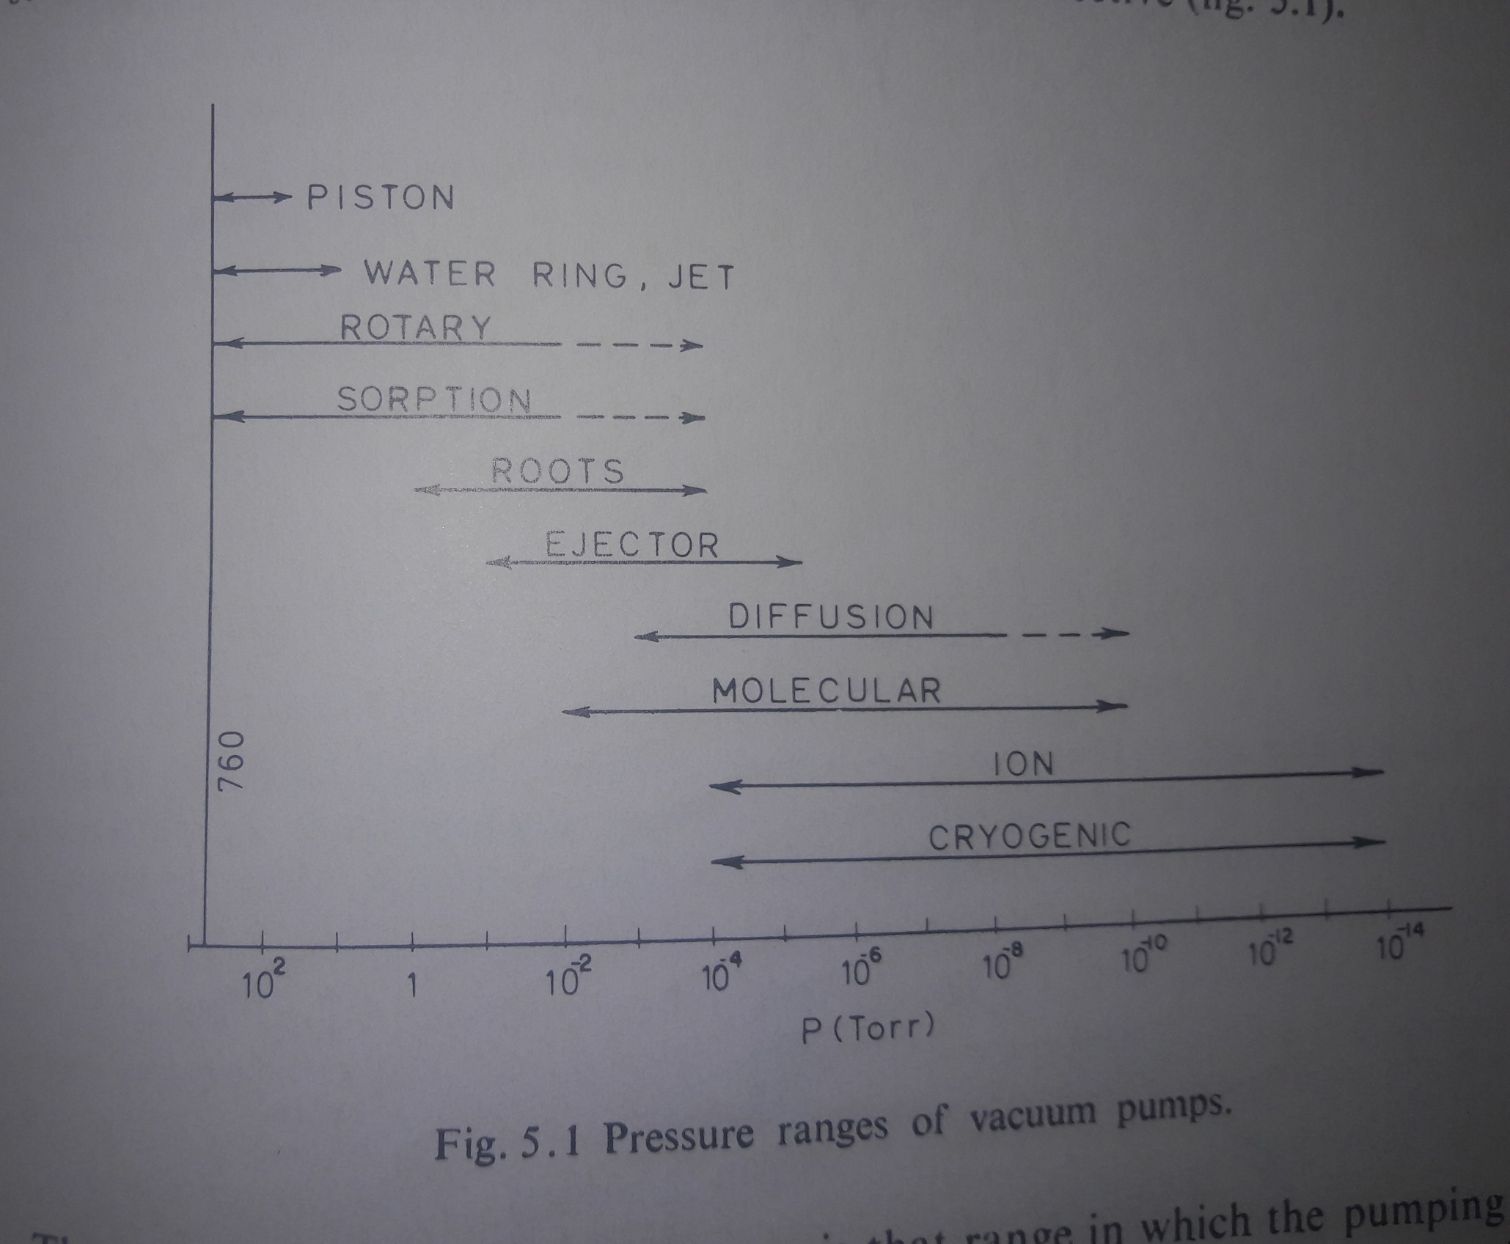

Slide 11
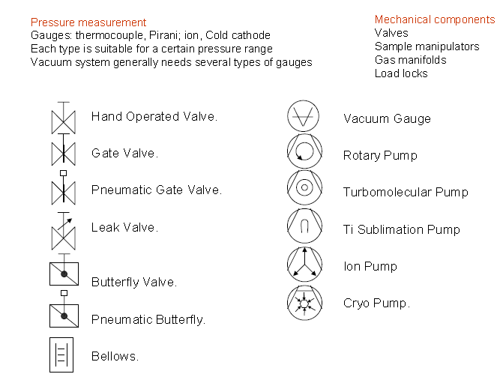

Slide 12
Engineering Vacuum Ranges
Rough Vacuum
Down to 10⁻³torr
Part viscous flow
Part free molecular flow
Gas flow and chemical reaction application
High Vacuum
10⁻⁶ torr to 10⁻⁹ torr
Completely free molecular flow
Long applications (evaporation and electron beams)
Ultrahigh vacuum
<10⁻⁹ torr
Keep surfaces clean

Slide 13
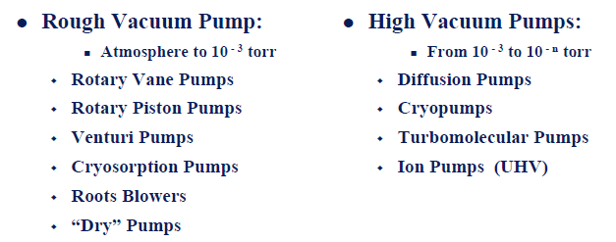
Positive Displacement Pumps

Slide 14
Positive Displacement Pumps
DIN 28400: Section 2(1980): ISO3529: Vacuum pump that aspirates, compresses and discharges a gas to be pumped, using valves if necessary, by means of pistons, rotors, sliders, etc. which are sealed from another either with or without liquids.
Oscillating positive displacement pumps
Piston pumps
Diaphragm pumps
Rotary positive displacement pumps
Single-spool Twin Spool
Liquid ring pumps Screw type pump
Sliding Vane rotary Claw Pumps
Multi stage pumps Roots Pumps
Rotary plunger pumps
Trochoidal pumps
Scroll pumps

Slide 15
Oscillating positive displacement pumps
Piston pumps
Diaphragm pumps
Piston Pump

Slide 16

Bent Axis Piston Pump

Slide 17
Swash Plate Piston Pump

Slide 18
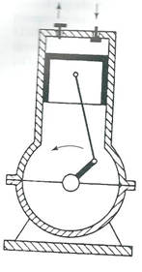
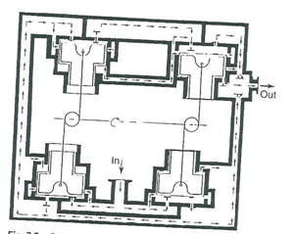
Single or double stage:
Ultimate pressure 500Pa to 10Pa
Four stage: Dia. of piston 100mm, Cylinder height 25.4mm, Pumping speed:34m³/h
Pressure: 1.5Pa-3Pa
Dead space
Wear
Modern Technology: fluroplastic coating and piston with special sliding surface

Slide 19
Diaphragm Pump

Slide 20
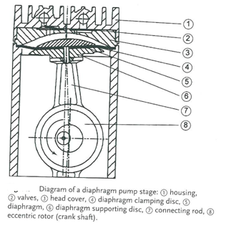

Pumping speed and Ultimate Pressure
Suction Chamber Volume = V_{S}
Rotational speed = n
Dead Space = V_{D.S.}
Pumping Speed = S
Monophase motor with nominal rotational speed 1500rpm

Slide 21
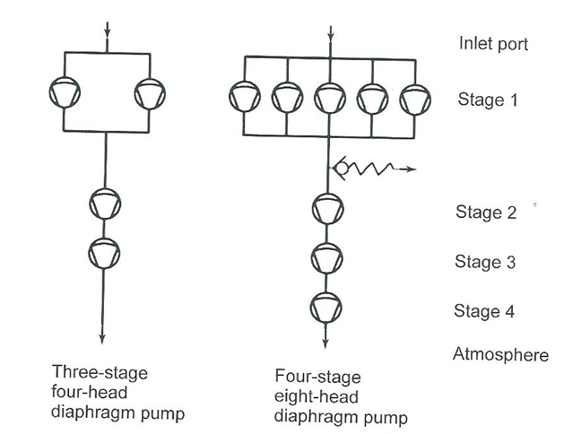
Ultimate pressure
Single stage: 8m³/h, 80mbar
Two stage: 4m³/h, 9mbar
Three stage: 2.8m³/h, 2mbar
Four stage: 2m³/h, 0.6mbar
Gas Ballast: Either prevents condensation or discharges condensate produced by the pump
Drive concept: Controlling the speed of pump
Frequency converter-controlled three-phase AC motors, preferably for large pumps.
Electronically communicated, brushless DC motor

Slide 22
PREVIOUS CLASSES
1- Error analysis
2- Precession, Resolution etc.
3- Examples of different applications of Vacuum Techniques
4- Units of Pressure and its conversions
5- Basics of Gas Properties
6- Gas laws
7- Velocity of gasses etc.
8- Molecular incident rate, Mean free path
9- Viscosity and diffusion of gases
10- Thermal diffusion: Distinction of gas flow and connections
11. Pumping speed and Vacuum PUMPS
1- Question: Modify the design of McLeod gauge for the better resolution of pressure measurement
2- Write a computer programme (Software development) to calculate the conductance for different connection design
3- Write a computer programme to calculate the throughput and pumping speed required for the vacuum chamber
Oscillatory Positive Displacement Pump

Slide 23
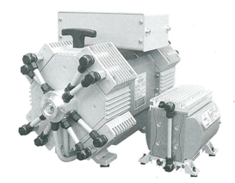
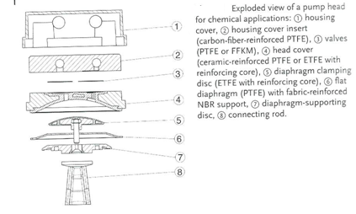
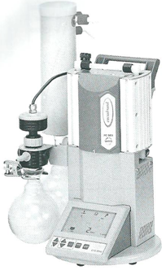
Influence of gas species on pumping speed and ultimate pressure
Influence of rotational speed on ultimate pressure
Pump Heads and diaphragm
Valves:FPM (Viton), PTFE (Teflon), EFKM or PEEK(Chemraz)
Materials:
Chemical laboratory
Baking pump for turbomolecular pumps

Slide 24
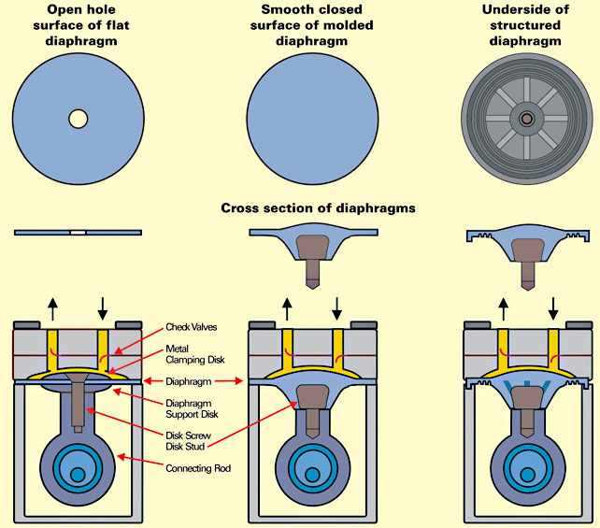

Slide 25
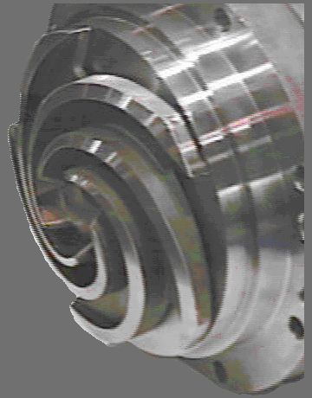
Liquid Ring vacuum pumps

Slide 26
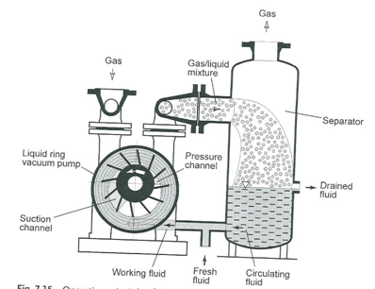
Liquid Ring vacuum pumps
Liquid ring compressors are built for suction volume flows below 10m³/h and upto above 10000m³/h
(V_{vapour}/V_{tot})=(P_{vapor}/P_{tot})
Using Dalton’s Law and assuming that the temperature T_{A} of the pumped area and adjusts to the temperature T_{B} of the working fluid by the time it enters into the impeller cells, pumping speed S calculates to
S_{A,dry}=S_{K}(T_{A}/T_{B})(288/293)[(P_{A}-P_{vapour,B})/(P_{A}-17.04_{hPa})]
Temperature is in K, S_{K} is the pumping speed at inlet pressure P_{A}. 17.04 hPa is the vapour pressure of water at 15C
(288/293) -> the air temperature deviation from 20C and the working fluid temperature deviating from 15C

Slide 27
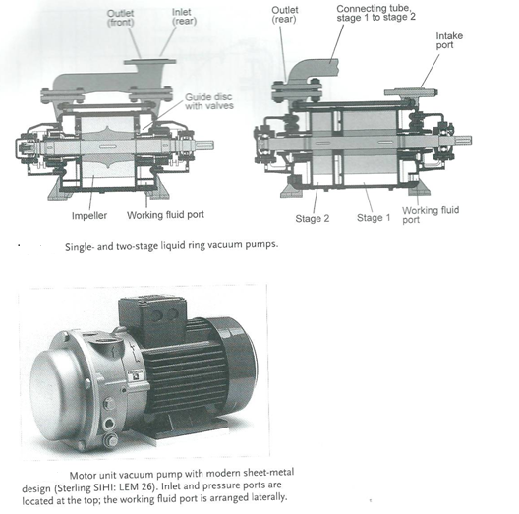
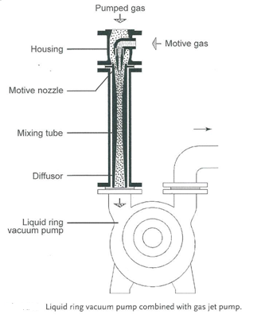
Liquid is water. But problem with chemicals

Slide 28
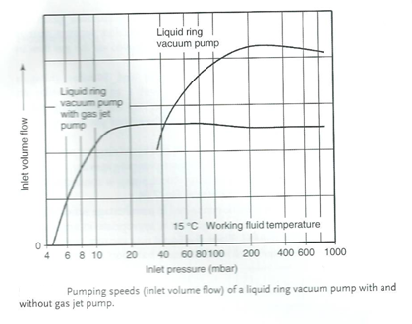

Slide 29
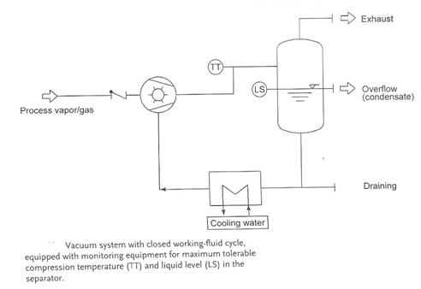
Operation and safety
Working fluid: oil, alkaline solutions, and acids
Fresh fluid mode
Combined fluid mode
4. Adjusting working fluid temperature
5. Speed control: 30%
6. Bypass control: A portion of the compressed gas, or atmospheric air is recirculated to the suction pump.

